Slide 1
Friends Café & Restaurant Sauravpreet Kumar 450
Sandeep
467
Manik
466

Slide 2
Introduction
Cafe, also spelled cafe, small eating and drinking establishment, historically a coffee house, usually featuring a limited menu. A restaurant is generally an establishment where the public may obtain meals or refreshments.

Slide 3
Objective
Design and develop an automated and user friendly website for customers for check in friends café & restaurants.
To analysis website using mobile first approach.

Slide 4
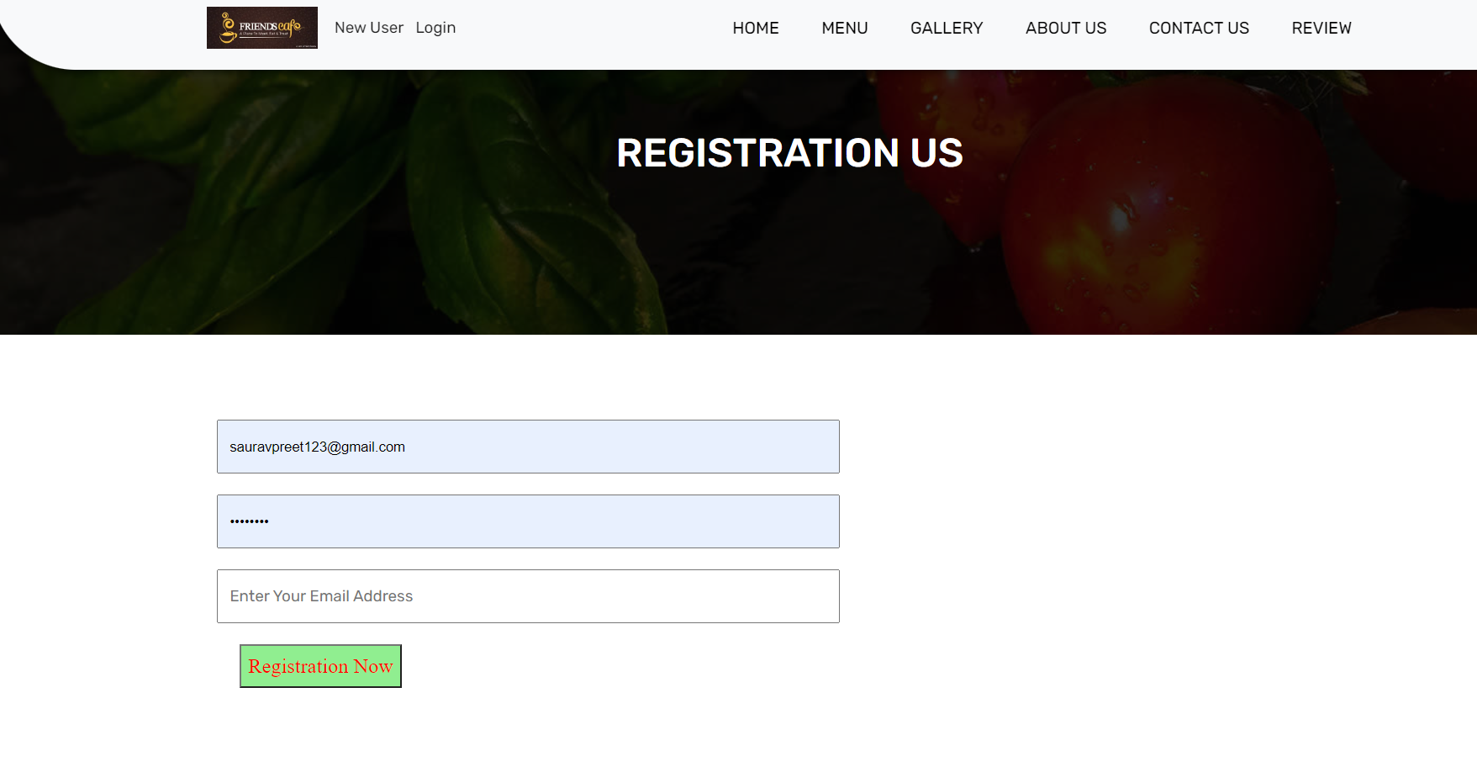
New user Registeration

Slide 5
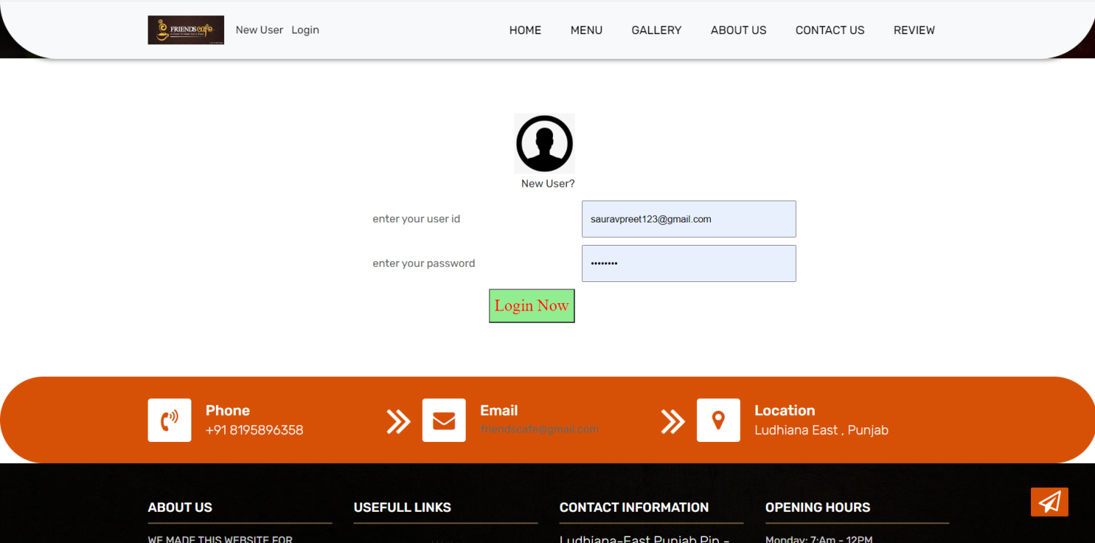
User Login

Slide 6
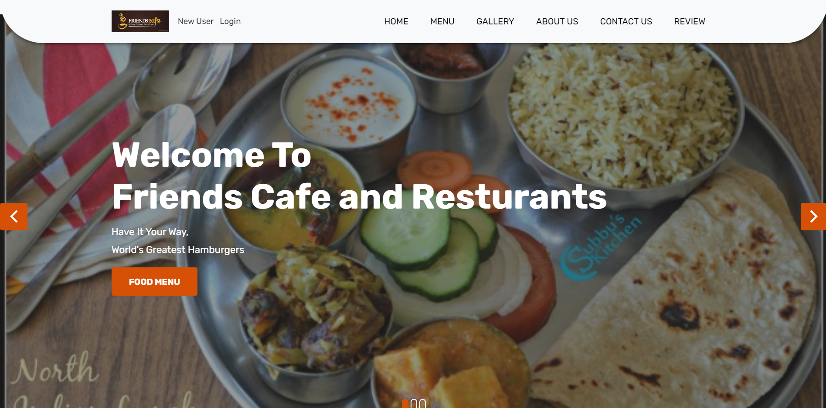
Home

Slide 7
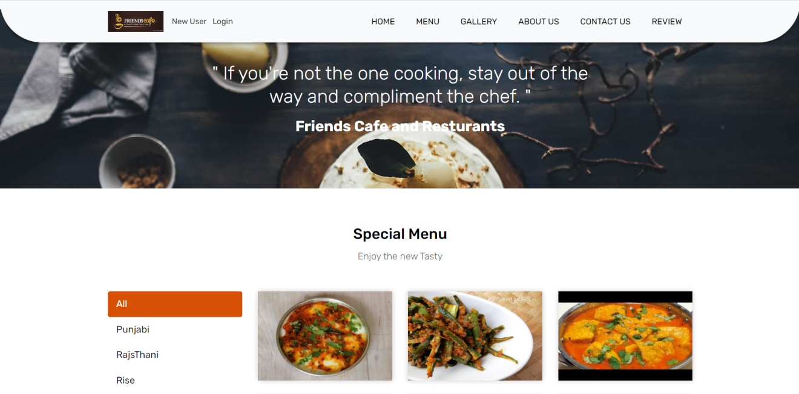
Menu

Slide 8
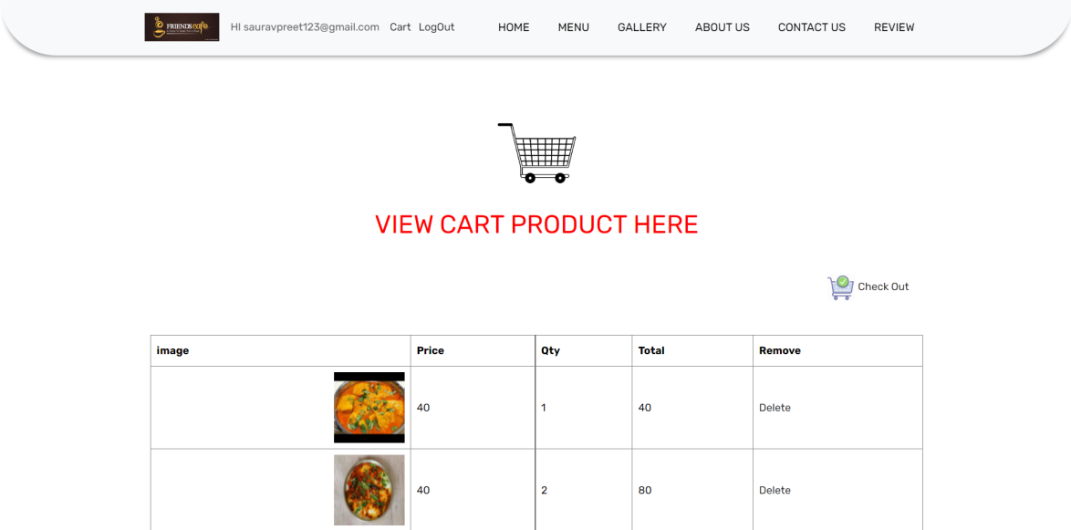
Cart

Slide 9
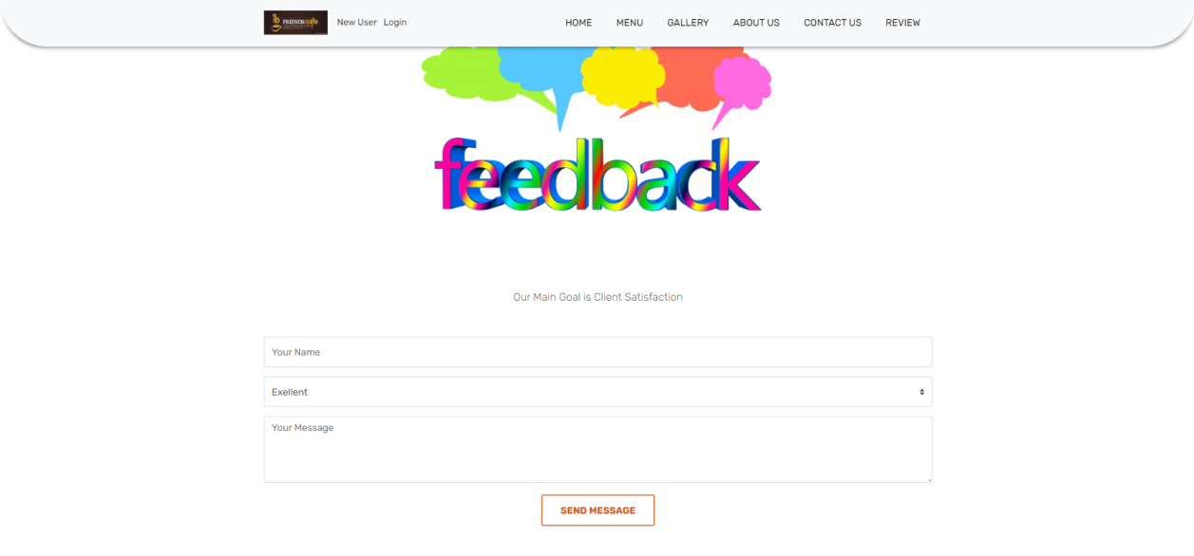
Review

Slide 10
Thank You

